Slide 1
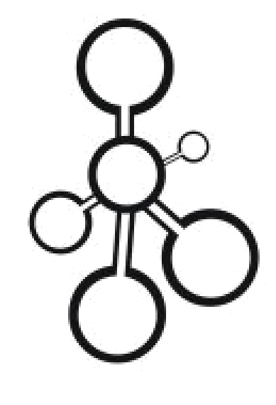
Data Structures
Git/GitHub

Slide 2

Version Control
It is a system that records changes to a file or set of files over time so that you can recall specific versions later.
Why?
Many of us create something, save it, change it, and save it again.
Version control is a means of managing this process in a reliable and efficient way.
It is especially important when collaborating with other people.
Notes:
Why stacks?

Slide 3
Git
Git is a free and open source distributed version control system designed to handle everything from small to very large projects with speed and efficiency
Basic Information
The most popular implementation of version control.
Everything is stored in local repositories on your local computer.
Operated from the command line.
Notes:
Why stacks?

Slide 4
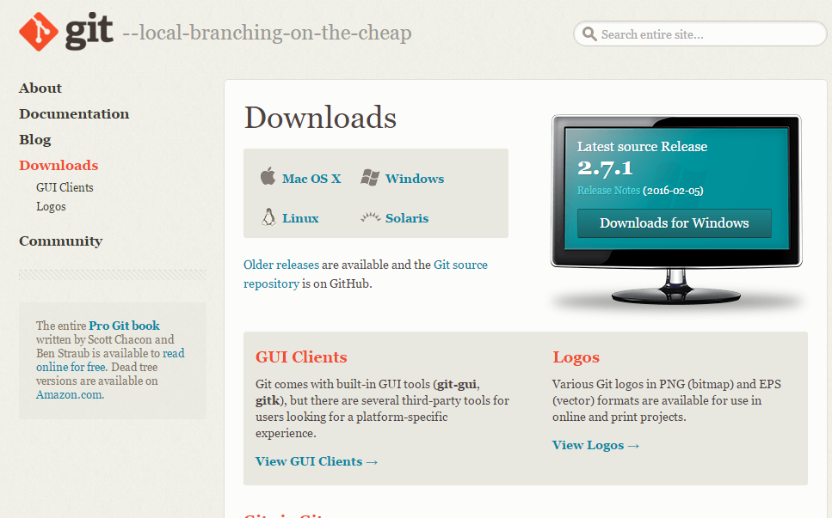
Download Git
Here is a link for downloading Git:
https://git-scm.com/downloads
Install Git (It’s pretty straightforward).
Open Git Bash.
Notes:
Why stacks?

Slide 5
Git Bash
Using the command line, configure username and email in this way:
git config --global user.name -- “your user name”
git config --global user.email -- “your email”
To confirm the changes, type the following in the command line:
git config --list
To exit Git, type:
exit
Notes:
Why stacks?

Slide 6
GitHub
GitHub is a web-based Git repository hosting service. It offers all of the distributed vision control functionality of Git.
GitHub allows you to:
Share your repositories with others.
Access other users’ repositories.
Store remote copies of your repositories (on GitHub’s server) in case something happens to your local copies.
Notes:
Why stacks?

Slide 7
Creating a GitHub Repository
You can either make a new repository from scratch of fork somebody else’s.
Start a new repo from scratch
Make an account on GitHub.com
Create a new repository (e.g. let’s name it cs303) with this link: https://github.com/new (public ones are for free, private ones are paid)
Notes:
Why stacks?

Slide 8
Creating a Local Copy
You need to make a copy of it on your local computer with Git Bash:
mkdir ~/cs303
Navigate to that folder:
cd ~/cs303
Initialize the repo:
git init
Point your local repo to the remote one (Make a pull request):
git remote add origin https://github.com/kuhailm/cs303.git
Notes:
Why stacks?

Slide 9

Forking Someone Else’s Repo
Go to the desired GitHub repo online, and click on the Fork button:
This will make a copy of the repository on your GitHub account.
Clone the repo using Git Bash:
git clone https://github.com/kuhailm/cs303.git
Notes:
Why stacks?

Slide 10
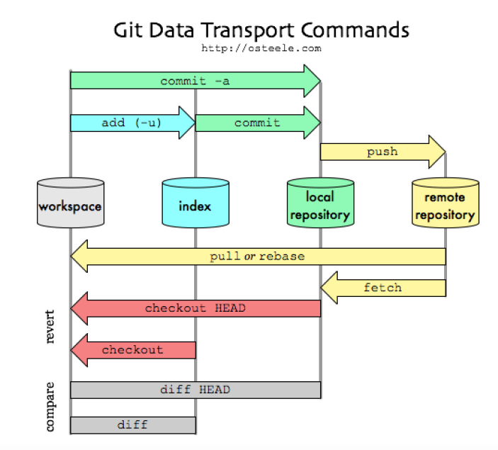
Basic Git Commands
Notes:
Why stacks?

Slide 11
Adding new files
If you want to add new files to a local repository under version control.
You need to let Git know that they need to be tracked
  git add . add all the files.
  git add -u updates tracking for files that changed names.
  git add -A does both of the previous.
This should be done before committing.
Notes:
Why stacks?

Slide 12
Committing
To commit the changes that you have made as an intermediate version, you type the following command:
  git commit –m “message”
This updates your local repo, not the remote one on Github.
Notes:
Why stacks?

Slide 13
Pushing
To push the changes you committed to your local repo, write the following command:
  git push
Notes:
Why stacks?

Slide 14
Branches
If you want to create an independent branch from the main(master) branch, type the following command:
  git checkout –b branchname
To see what branch you are on, type:
  git branch
To switch back to the master branch, type:
  git checkout master
Notes:
Why stacks?

Slide 15
Pull Requests
Pull requests let you tell others about changes you've pushed to a repository on GitHub. Once a pull request is sent, interested parties can review the set of changes, discuss potential modifications, and even push follow-up commits if necessary.
Pull request is a Github feature. To create a pull request, do the following:
  Switch to your branch
  Click new pull request
After starting the review, you're presented with a review page where you can get a high-level overview of the changes between your branch and the repository's master branch.
You can review all comments made on commits, identify which files changed, and get a list of contributors to your branch.
Notes:
Why stacks?

Slide 16
References
Git Documentation: https://git-scm.com/documentation
Github Help: https://help.github.com/
Notes:
Why stacks?

